Slide 1

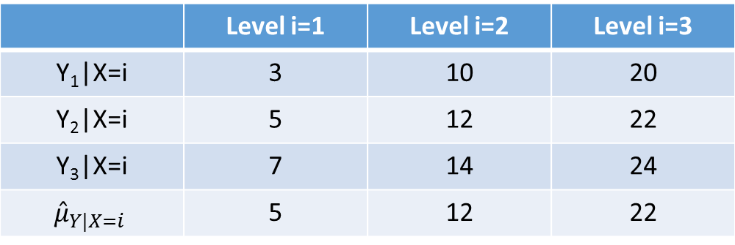
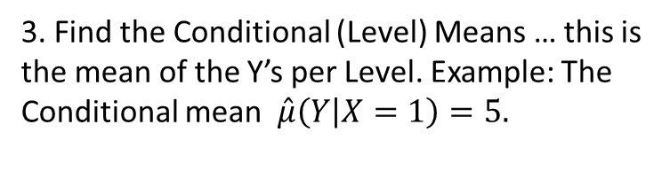
ANOVA
1. Make a Scatterplot of the data in the table below. “Level” is
the Explanatory Variable (X=1, 2, or 3).
 | Level i=1 | Level i=2 | Level i=3
Y₁|X=i | 3 | 10 | 20
Y₂|X=i | 5 | 12 | 22
Y₃|X=i | 7 | 14 | 24
$${\hat{μ}}_{Y|X=i}$$ | 5 | 12 | 22
2. Find the Grand Mean … this is the mean of all the Y’s together … regardless of Level.
$$\hat{μ}=\overset{̿}{x}=13$$
3. Find the Conditional (Level) Means … this is the mean of the Y’s per Level. Example: The Conditional mean $\hat{μ}\left(Y | X=1\right)=5.$

Slide 2
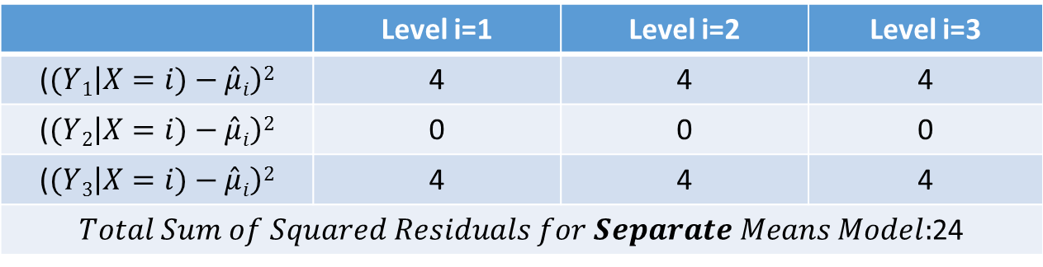
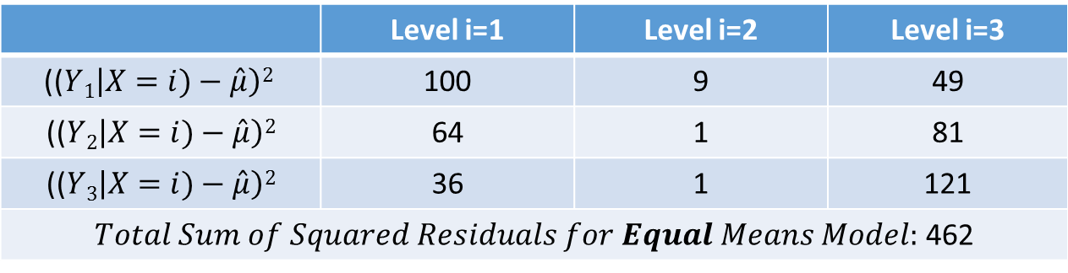
Pure ANOVA
4. Now we need to find the Sum of the Squared Residuals for the Equal Means Model.
($(Yi\left|X)−\hat{μ}\right)2$
 | Level i=1 | Level i=2 | Level i=3
(($Y1\left|X=i)−\hat{μ}\right)2$ | 100 | 9 | 49
(($Y2\left|X=i)−\hat{μ}\right)2$ | 64 | 1 | 81
(($Y3\left|X=i)−\hat{μ}\right)2$ | 36 | 1 | 121
$Total Sum of Squared Residuals for Equal Means Model:$ 462
5. Now we need to find the Sum of the Squared Residuals for the Separate Means Model, where $\hat{μ}i$ = $\hat{μ}(Y|X=i)$.
($(Yi\left|X=i)−\hat{μ}i\right)2$
 | Level i=1 | Level i=2 | Level i=3
($(Y1\left|X=i)−\hat{μ}i\right)2$ | 4 | 4 | 4
($(Y2\left|X=i)−\hat{μ}i\right)2$ | 0 | 0 | 0
($(Y3\left|X=i)−\hat{μ}i\right)2$ | 4 | 4 | 4
$Total Sum of Squared Residuals for Separate Means Model:$24
6. Compare the Total Sum of Squares for each model. Which do you think “fits” better?

Slide 3
Pure ANOVA
7. Now we would like to make an ANOVA table to test the alternative hypothesis!
Formally write the Ho and Ha and fill in the table.
 | df | SS | MS | F | Pr > F
Model / Extra SS | 2 | 438 | 219 | 54.75 | .0001
Error / Residual/Full Model | 6 | 24 | 4
Total (Reduced) | 8 | 462
Extra Sum of Squares = Residual Sum of Squares Reduced – Residual Sum of Squares Full

